Slide 1
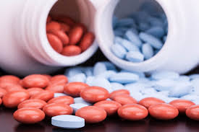
MAP4484 Team Green
Sophia Blumenfeld, Annika Holmstrom, Steven Miltenberger, and Samuel Thomas
Notes:
Steven

Slide 2
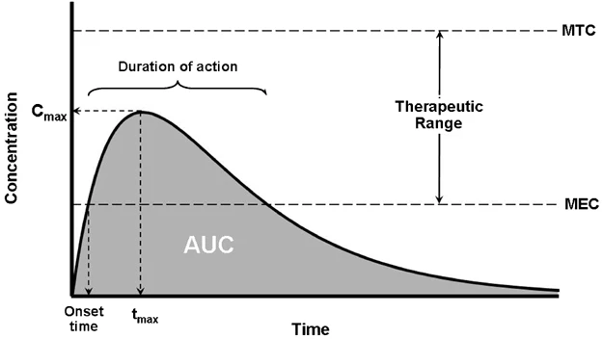
Introduction
When we take medication, the body absorbs it into the bloodstream
Concentration changes constantly
Concentration must be above Minimum Effective Concentration (MEC) to feel effects
Concentration must be below Maximum Tolerance Concentration (MTC) to avoid harm
Duration of action is the difference between the onset time and time for the drug to reach MEC
Onset time is when the concentration reaches MEC
Cmax is the maximum concentration achieved
Figure source: The role of pharmacokinetics and pharmacodynamics in phosphodiesterase-5 inhibitor therapy by N. Mehrotra, M. Gupta, A. Kovar, and B. Meibohm, doi: 10.1038/sj.ijir.3901522
Notes:
Steven

Slide 3
Problem Statement
Objective: Determine the optimal treatment plan for pain for each patient over one week following surgery
3 Patients
Patient #1: Prescribed oxycodone
Patient #2: Prescribed ibuprofen
Patient #3: Prescribed oxycodone and ibuprofen combination
Notes:
Steven

Slide 4
Assumptions
Each patient:
Has no other medical risk factors such as a compromised liver or kidney disease
Is not taking any other medications with known drug interactions
Has no history of built-up narcotic tolerance from other medications
Does not regularly smoke or drink alcohol excessively
Is not in their third trimester of pregnancy or breastfeeding
Takes each medication on an empty stomach
Does not miss any doses of medication
Does not have any allergic reactions or experience adverse effects that would end treatment early
Has access to a standard pharmacy with readily-available tablets in discrete dosages
Has a blood volume of 5 liters
Notes:
Steven

Slide 5
Background Research
For adult patients, drug absorption rates did not demonstrate statistically significant differences for age (15-65), race, weight, height, or gender
Drug absorption is not impacted by obesity and the distribution of the drug and plasma concentration is not affected with oral opioid medications once the steady state is reached
In children and elderly the metabolism is different so therefore the dosage would need to be adjusted
Opioid prescriptions don’t have to be tapered to counteract symptoms of addiction and withdrawal if taken for less than two weeks since the body has not built up tolerance
Oxycodone extended-release capsules are only used if the patient is already taking opioids so in our study we only prescribe immediate release capsules
Notes:
Sophia and Annika

Slide 6
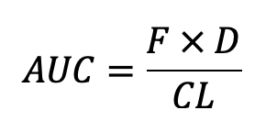
Defining Variables
Independent Variable: Drug dosage in milligrams, drug type, and time
Dependent Variable: Concentration in the blood per hour
Cmax and tmax are dependent on the dosage used
MEC and MTC are dependent on the drug type
AUC, which gives insight into the extent of exposure to the drug and its clearance rate from the body, is dependent on the dosage and the drug type (bioavailability)
Pain level was accounted for in our suggested treatment plan
Legend
AUC = area under the curve
F = bioavailability of the drug
D = dosage in milligrams
CL =clearance rate from the body
Notes:
Sophia

Slide 7
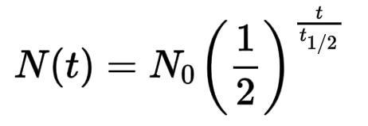
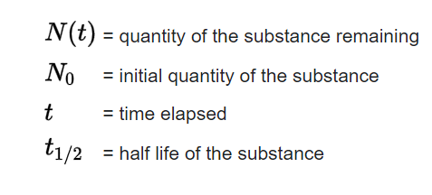
Half-Life Equation
The following half-life equation was used to determine the quantity of each drug in a patient’s body each hour
Half-life
Oxycodone: 4 hours
Ibuprofen: 2 hours
We compared the concentration of the drug in the patient’s body to the stated therapeutic ranges of each drug in different treatment plans
Notes:
Sam

Slide 8
Patient 1: Oxycodone
Drug Information:
Therapeutic Range: 10-100 ng/mL
Onset of Action: 10-30 minutes
Peak Effect: 1-2 hours
Duration Range: 3 to 6 hours
Bioavailability: 60 - 87%
Clearance: 1.4 L/min
Available in 5 mg, 10 mg, 15 mg, 20 mg, 30 mg
Suggested Treatment Plan:
Severe pain: 15mg Immediate Release Tablets orally every 6 hours
Moderate pain: 10mg Immediate Release Tablets orally every 5 hours
Mild pain: 5mg Immediate Release Tablets orally every 4 hours
Notes:
Sam

Slide 9
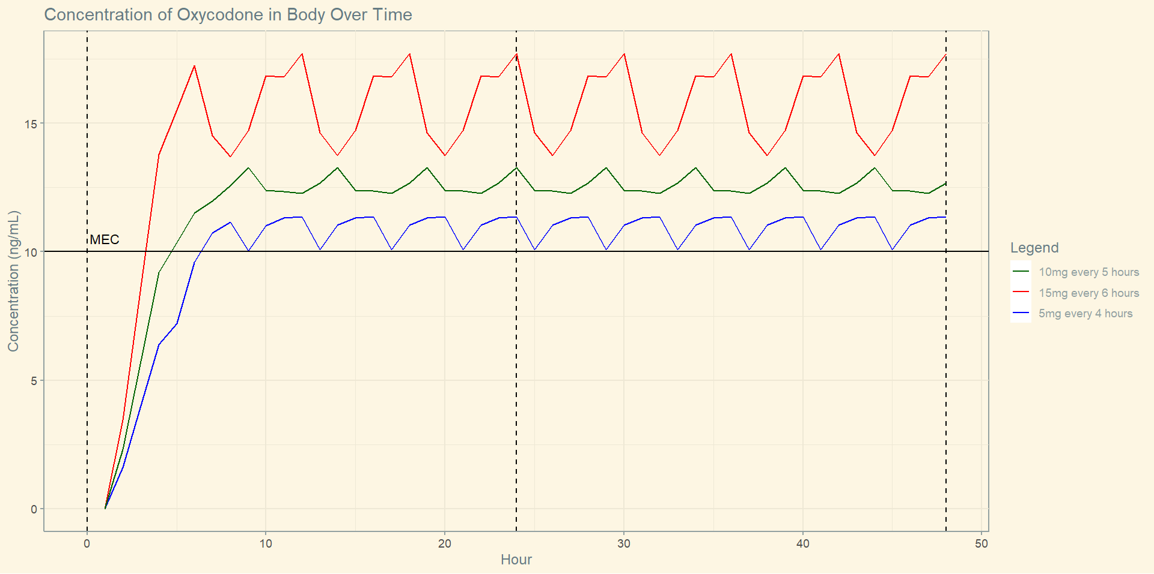
Patient 1: Graph
Notes:
This graph is assuming that patients are waking up in the night to continually take their medication. Sam

Slide 10
Patient 2: Ibuprofen
Drug Information
Therapeutic Range: 10-50 mg/L (toxic > 100 mg/L)
Onset of Action: 30-60 minutes
Peak Effect: 1-2 hours
Duration Range: 4 to 6 hours
Bioavailability: 100%
Clearance: 3-13 L/hr
Suggested Treatment Plan
400 mg tablets orally every 4 hours
Notes:
Sophia

Slide 11
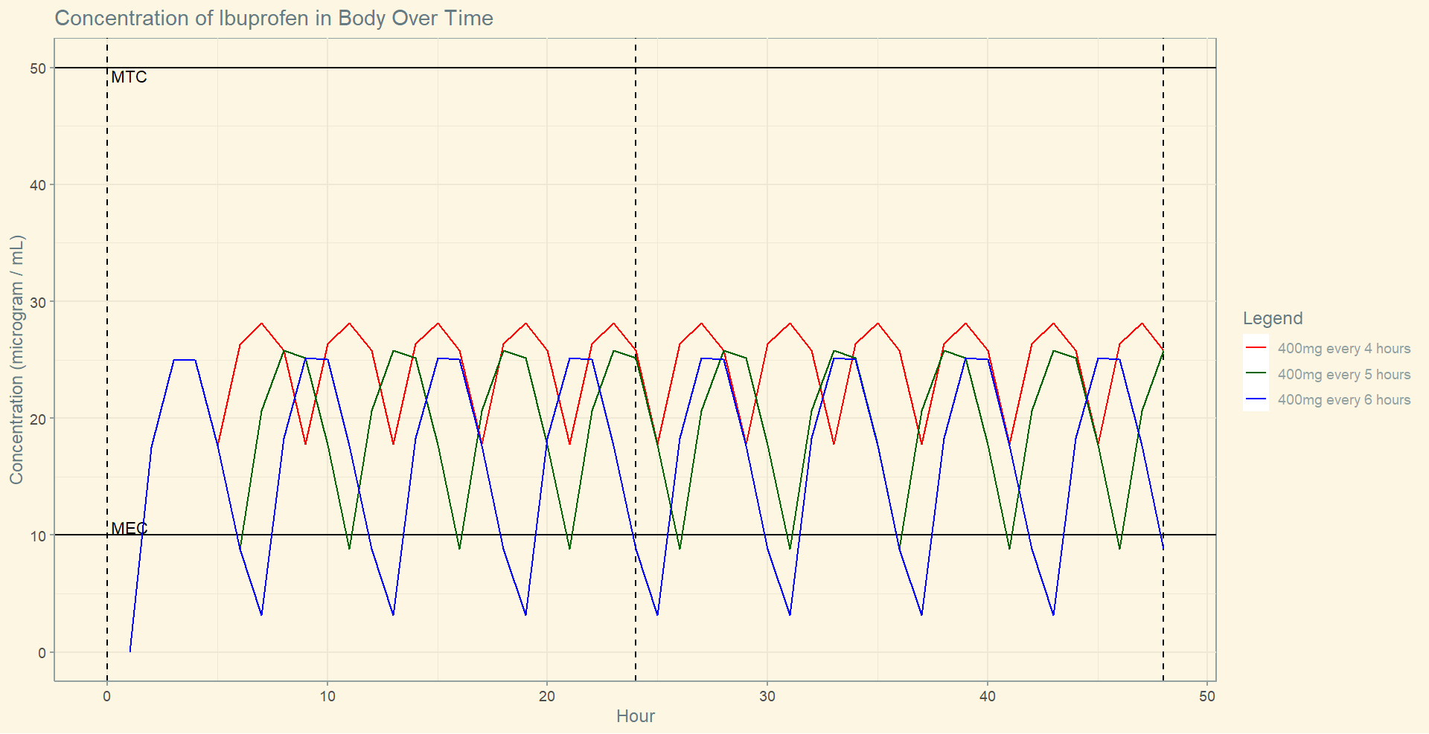
Patient 2: Graph
Notes:
Sophia

Slide 12
Patient 3: Ibuprofen and Oxycodone
Combining analgesics with different modes of action can produce additive effects in cases of acute pain
Able to use lower doses with less severe adverse effects
The exact mechanisms of action are unknown for ibuprofen and oxycodone
Ibuprofen is an NSAID (nonsteroidal anti-inflammatory drug)
Oxycodone is able to bind to opioid receptors in the brain
Both are separately metabolized by the liver and eliminated in urine
Notes:
The exact mechanisms of action are unknown for ibuprofen and oxycodone but looking at what drug class they fall under provides some insight
Ibuprofen is an NSAID (nonsteroidal anti-inflammatory drug) which reversibly inhibit the production of certain enzymes that play an important role in inflammatory processes
Oxycodone is able to bind to opioid receptors in the brain to reduce the release of neurotransmitters so sensory nerves are less receptive to pain
Both are metabolized by the liver and eliminated in urine
Annika

Slide 13
Patient 3: Ibuprofen and Oxycodone
Ibuprofen Therapeutic Range: 10-50 mg/L (toxic > 100 mg/L)
Oxycodone Therapeutic Range: 10-100 ng/mL
Suggested Treatment Plan: 5 mg of oxycodone and 400 mg of ibuprofen orally every 6 hours
Notes:
Annika

Slide 14
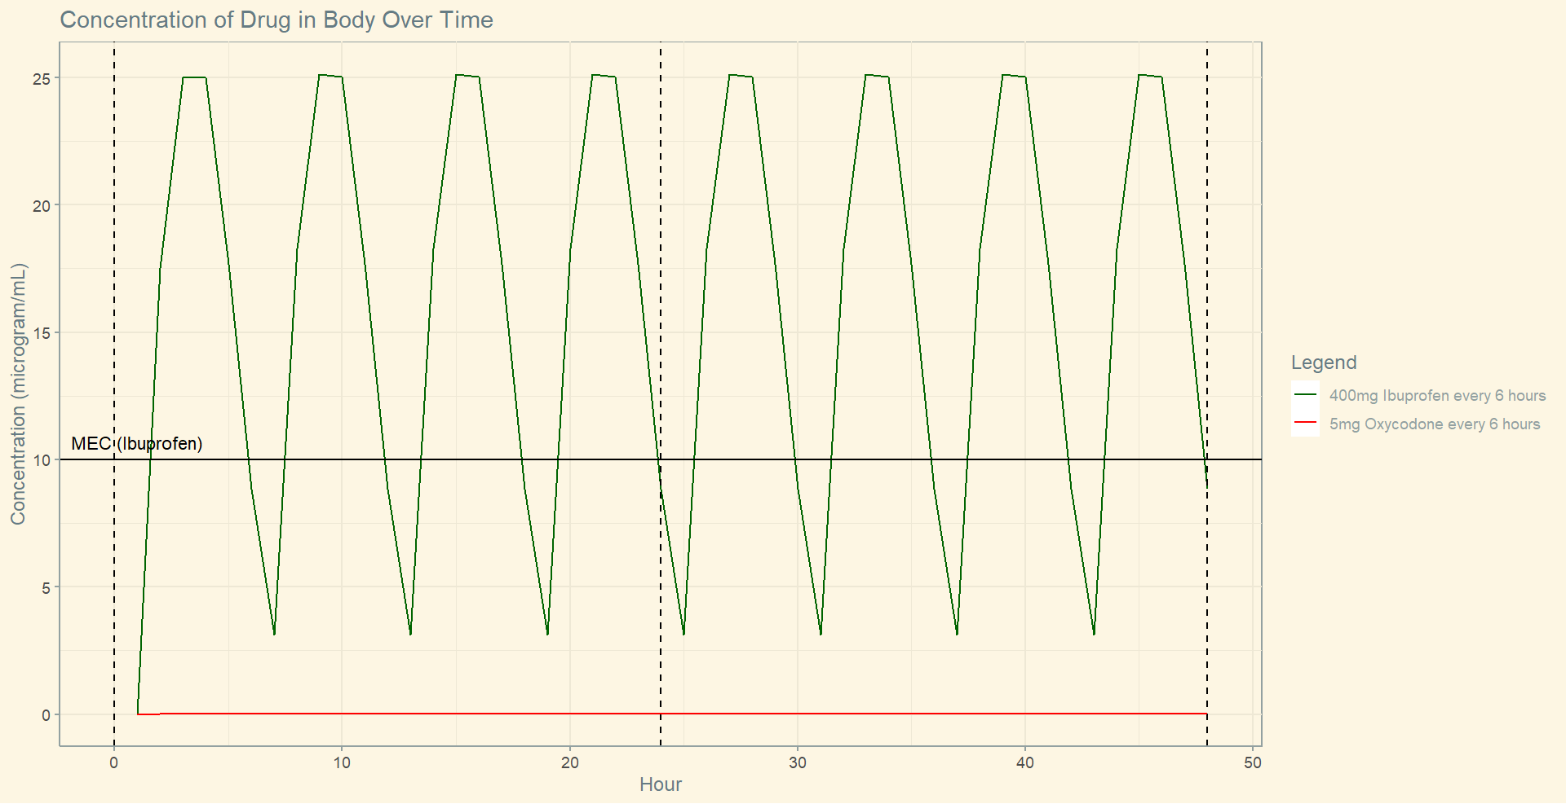

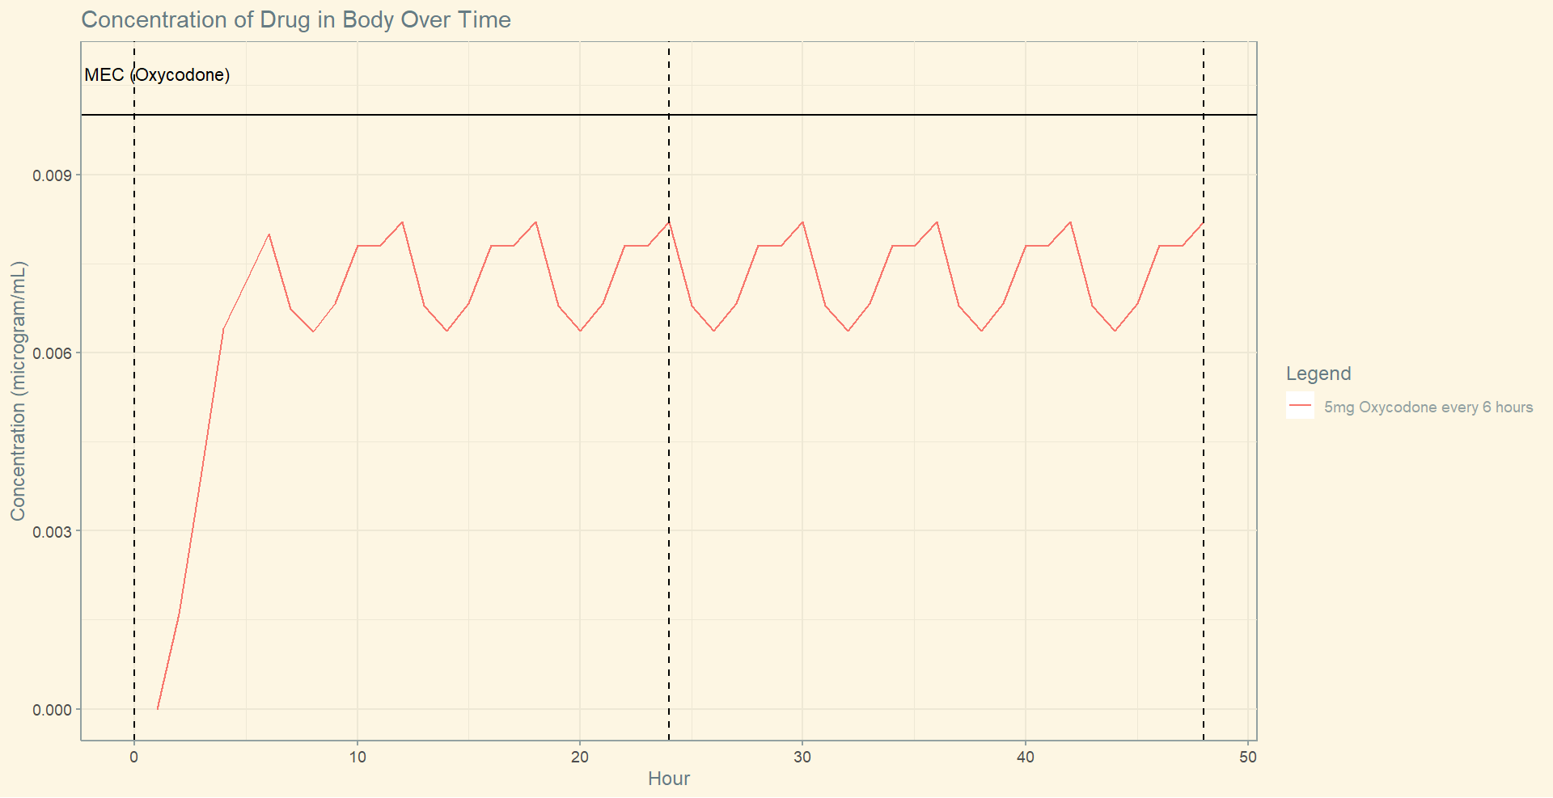
Patient 3: Graph
Notes:
Annika

Slide 15
Conclusions
Strengths
Accounts for onset time, bioavailability, and clearance rate
Prescribed medications are in standard doses
Weaknesses
Assumes patient has blood volume of 5 liters
Assumes all doses are taken on time
Assumes medication taken on empty stomach
Improvements
Account for changes in clearance rate for patients with liver or kidney problems
Account for changes in onset time if doses are taken with food
Notes:
Steven
absorption wont change
clearance will change if problems with liver kidney
pregnancy and breastfeeding wont change model but dangerous - addiction for child
food - changes onset time, doesnt change cmax
other medication can be affected by this medication

Slide 16
Sources
Recommended Doses
https://www.mayoclinic.org/drugs-supplements/oxycodone-and-ibuprofen-oral-route/proper-use/drg-20062031
https://www.mayoclinic.org/drugs-supplements/ibuprofen-oral-route/proper-use/drg-20070602
https://www.mayoclinic.org/drugs-supplements/oxycodone-oral-route/proper-use/drg-20074193
Oxycodone
https://www.cdc.gov/drugoverdose/pdf/calculating_total_daily_dose-a.pdf
https://www.hss.edu/conditions_patient-guide-opioid-tapering.asp
https://www.ncbi.nlm.nih.gov/books/NBK482226/
https://go.drugbank.com/drugs/DB00497
Ibuprofen
https://www.aae.org/specialty/communique/ibuprofen-well-know-favorite-drug/#:~:text=The%20maximum%20recommended%20daily%20dose,%3E100%20mg%2FL
Combination
https://www.ncbi.nlm.nih.gov/pmc/articles/PMC6494203/
Other Factors such as fasting, weight, etc.
https://academic.oup.com/jpp/article/64/4/465/6135247
https://accp1.onlinelibrary.wiley.com/doi/full/10.1002/cpdd.672
https://medsask.usask.ca/documents/mednews-docs/Benzodiazepine-Dosing-in-Obesity.pdf
https://www.ncbi.nlm.nih.gov/pmc/articles/PMC5675036/#:~:text=Oxycodone%20and%20hydrocodone%20pharmacokinetic%20and%20pharmacodynamic%20effects%20did%20not%20differ%20by%20gender.

